Slide 1
How was Brazil’s Crime Rate affected by hosting the 2016 Rio Olympics?
Assumption:
I’m assuming that with the increase in population due to hosting the Olympics, I suspect that the opportunity for crime will rise and we will see an increase in occurrences up to the year of the Olympics.

Slide 2


My Data Sources:
Establishes a “Crime Index” which is “is an estimation of overall level of crime in a given city or a country.”
Data is collected by survey from people who live in that city/country
UNODC - United Nations Office of Drugs and Crime
“Data is collected from national authorities through the annual United Nations Crime Trends Survey (UN-CTS)”
The rates in the data represent police-recorded offences, per 100,000 population.

Slide 3
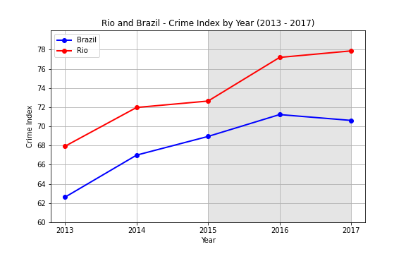
Brazil and Rio de Janeiro - Crime Index
The Blue line represents Brazil’s Crime Index and we can see a rise going until 2016 and a slight dip in 2017.
The Red line represents Rio and we can see that the Crime Index is higher and increases steadily over the 5 year period.
The highlighted area of the graph is 2015-2017 giving us an idea of a before, during, and after of hosting the Olympics.

Slide 4
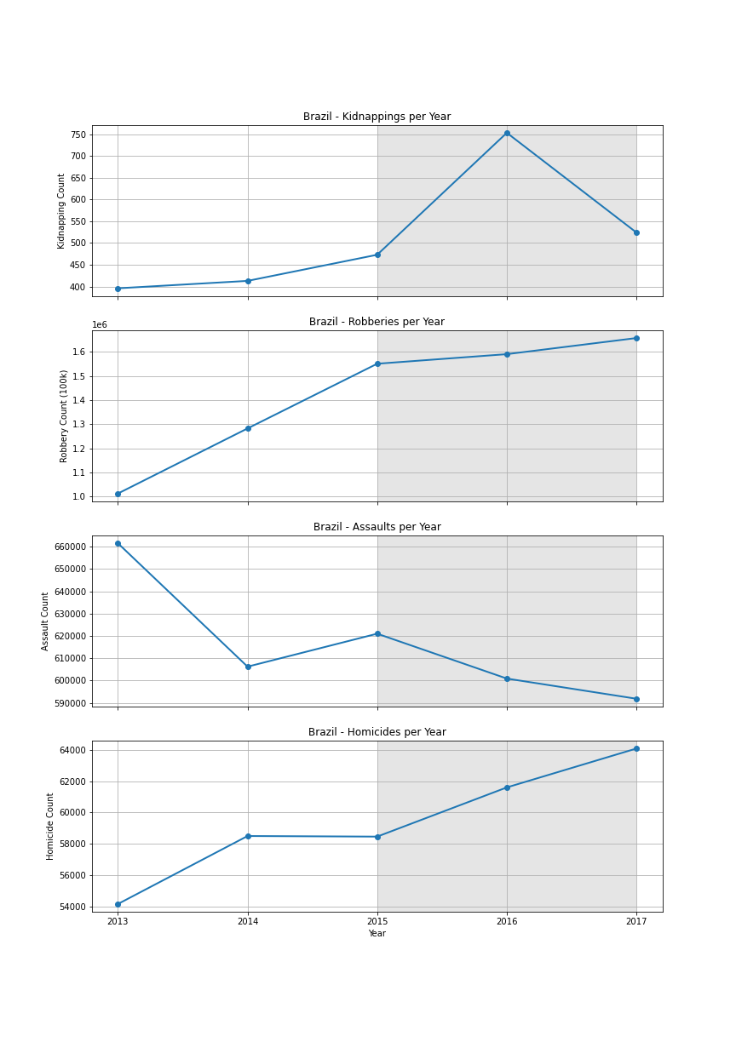
Brazil - Violent Crime Count
First graph shows Kidnappings. We can see a steady increase in occurrences up until 2016 when there was a big spike and then it went back down.
Second graph shows Robberies. There is a big increase in Robberies occurring and continues to increase before during and after the Olympics.
Third graph shows Assaults which is the only crime I looked at that had a downward trend that was consistent over the 5 years.
The final graph shows Homicides. The visualization shows how that Homicides flattened out from 2014 to 2015 then there was a big increase before during and after the Olympics.

Slide 5
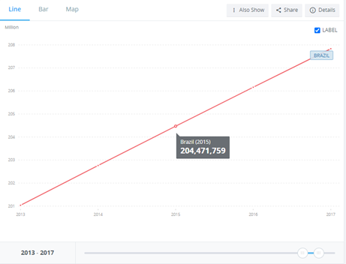
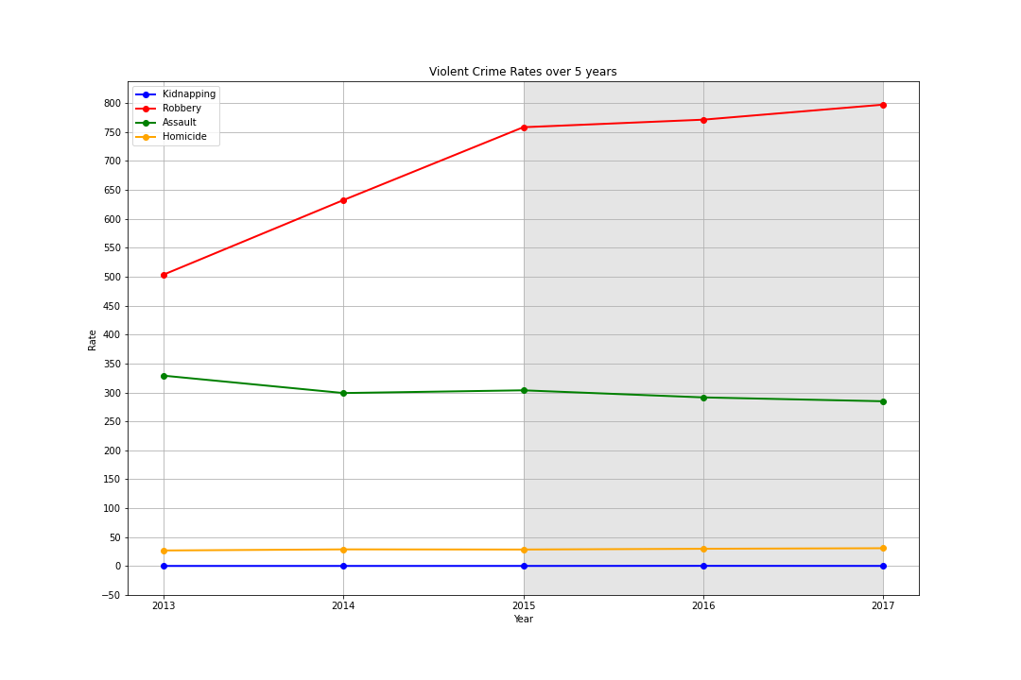
Brazil - Crime Rates
As you can see, you are very likely to be robbed in Brazil. The amount of Robberies that were happening were increasing as the population increased.
The green line shows Assaults which stayed relatively consistent as the population increased with a slight downwards trend
Yellow line is Homicide and Blue line is Kidnapping and as you can see they stayed relatively consistent as the population increased.

Slide 6
Conclusion - Brazil Crime Rates
Q: How was Brazil’s Crime Rate affected by hosting the 2016 Rio Olympics?
A:
When looking at the number of occurrences of violent crimes, 3 out of the 4 violent crimes that I looked at increased in the 3-year period around the Olympics representing before, during and after.
When we look at the rates of these crimes, it can be explained by the increasing population in Brazil. The only crime with a clear increase in Rate is Robbery. Robberies increased even as the population increased.
The other 3 violent crime rates stayed consistent as the population increased. Occurrences of the crimes increased relative to how much the population increased.

